Slide 1

OWNER’S MANUAL
TRINITY PRO 18.5” GARAGE BASE CABINET W/DRAWERS
Model # TSNPBK-0607
FOR QUICK & EASY 3D ASSEMBLY INSTRUCTIONS
POUR DES DIRECTIVES D’ASSEMBLAGE 3D RAPIDES ET FACILES
PARA INSTRUCCIONES DE ENSAMBLAJE RÁPIDAS Y SENCILLAS EN 3D

Slide 2

© 2020 TRINITY - 800.985.5506

Slide 3
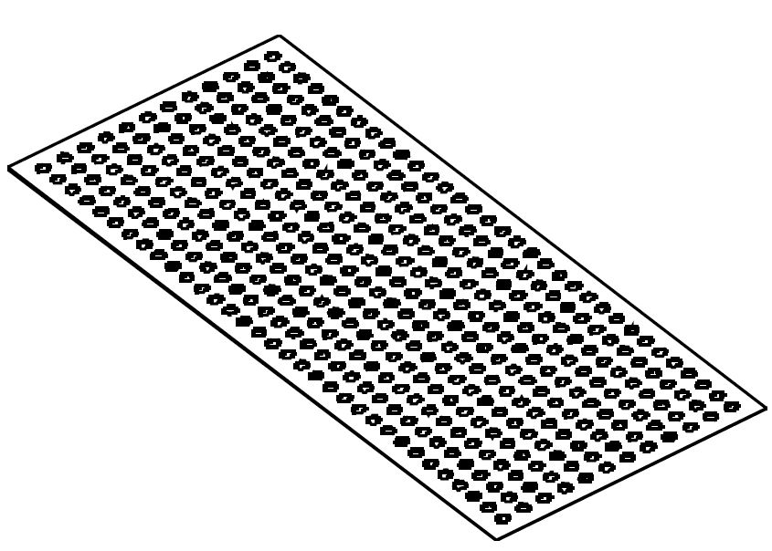
PARTS LIST
Your TRINITY PRO 18.5“Garage Base Cabinet w/Drawers should include the following parts. Please inspect box contents to ensure you have received all components.
If you are missing any parts, need assistance with assembly or have questions, please contact TRINITY Customer Service: 800.985.5506 or customerservice@trinityii.com. Parts can also be requested online via “Contact Us” section at www.trinityii.com.
No tools required for assembly.
A
B
C
D
CABINET BODY (1)
FEET LEVELER (4)
DRAWER LINER (4)
KEY (2)
E
WOOD SCREW (4)
Option: only use for
mounting wood top
LOCATION OF PARTS:
KEYS (D) are hooked to key leash mounted inside Top Drawer.
FEET LEVELERS (B) and WOOD SCREW (E) are boxed inside Second Drawer.
LINERS (C) are packed inside Second Drawer.
© 2020 TRINITY - 800.985.5506

Slide 4
ASSEMBLY INSTRUCTIONS
STEP 1
Location of parts: KEYS (D) are hooked to key leash mounted inside Top Drawer. FEET LEVELERS (B) and DRAWER LINERS (C) are packed inside Second Drawer.
Lay CABINET BODY (A) gently on its back. Two people are needed, do NOT attempt this alone.
Screw each FEET LEVELER (B) fully into each pre-installed nut on four corners of cabinet bottom.
Stand cabinet right side up.
Move it to desired location. Adjust each FEET LEVELER (B) as needed to ensure your cabinet is level and stable.
A (1)
B (4)
A
B
STEP 2
Simply place LINERS (C) in each drawer.
A
C (4)
C
© 2020 TRINITY - 800.985.5506

Slide 5
USAGE INSTRUCTIONS
DRAWER REMOVAL
Pull drawer out so that it is almost fully extended. On RIGHT side, push black release lever DOWN. On LEFT side, pull black release lever UP. While holding levers as instructed, pull drawer forward until released from slides attached to Cabinet (“Cabinet Slides”).
Note: Slides attached to drawer (“Drawer Slides”) are an integral part of drawer and must be removed along with drawer itself.
DRAWER REPLACEMENT
To replace drawer, pull slides out completely. Insert brackets on each side of Drawer Slides into corresponding slots on Cabinet Slides, making sure they are properly positioned. Once brackets are inserted into slots, completely close drawer to set all slides in their proper positions.
© 2020 TRINITY - 800.985.5506

Slide 6

SERVICE PARTS LIST – TSNPBK-0607
TRINITY Customer Service provides the following replacement parts:
 | Part Number | Description |  | Part Number | Description
1) | PBK-18-029-1831 | Cabinet Body | 8) | XBK-22-008-1616 | Drawer Liner
2) | PBK-07-016-1704 | Small Drawer | 9) | PBK-07-016-1711 | Large Drawer
3) | XBS-05-030-1575 | Drawer Handle | 10) | XBS-02-029-0002 | Handle Bracket
4) | PBK-07-016-1707 | Medium Drawer | 11) | XBK-02-028-0002 | Plastic Spacer
5) | ZSV-12-017-1375 | Slide (cabinet side) | 12) | CSV-11-005-0XXX | Lock
6) | ZSV-12-016-1375 | Slide (drawer side) | 13) | XBK-10-003-0XXX | Key
7) | XBS-98-012-1662 | Feet Leveler | 14) | XBK-02-054-0001 | Key Leash
14
1
13
12
2
11
3
10
4
9
5
6
8
7
© 2020 TRINITY - 800.985.5506

Slide 7
WARNINGS
Read and understand all instructions. Failure to follow all instructions may result in injury and/or damage.
The warnings, cautions, and instructions discussed in this manual cannot cover all possible conditions or situations that may occur. The user must always be aware of their environment and ensure that they use the product in a safe and responsible manner.
Do NOT modify the product in any way. Unauthorized modification may impair the function and/or safety of the product, and may affect the life of the product.
Check for damaged parts. Before using this product, carefully check that all parts are in good condition, and that the product will operate properly and perform its intended function. Check for damaged parts and any other conditions that may affect the operation of this product. Replace damaged or worn parts, and never use this product with a damaged part.
Do NOT overload the product. Below capacity is based on evenly distributed weight.
Lock the drawers before moving the cabinet.
Do NOT open more than one drawer at a time. Tipping can occur.
Do NOT step or lean on open drawers. Tipping can occur.
Load the cabinet starting with the bottom drawers to prevent cabinet from tipping.
Make sure all drawers are closed tightly before locking or unlocking.
Weight capacity per drawer (evenly distributed) | 100 lb
Total weight capacity of cabinet (evenly distributed) | 400 lb
CARE AND MAINTENANCE
Avoid harsh, abrasive cleaners, and other corrosive chemicals.
Do not use scouring pad for cleaning.
This item is not certified for outdoor use.
© 2020 TRINITY - 800.985.5506

Slide 8
© 2020 TRINITY - 800.985.5506

Slide 9
PRODUCT REGISTRATION
Thank you for purchasing a TRINITY PRO 18.5” Garage Base Cabinet w/Drawers. In order to register your product and receive streamlined customer service, please fill out the following Product Registration Form and (1) fax the form to 310.347.4134 (2) complete the Product Registration Form online at www.trinityii.com or (3) scan and email the form to customerservice@trinityii.com. Include a copy of your original receipt with your submission.
First Name: Last Name:
Address:
City: State: Zip Code:
Email Address: Phone:
Product Model #: TSNPBK-0607 Purchase Date: / /
Location of Purchase:
Please rate the importance of each feature (1=least important; 10=most important)
Quality Price Size/Capacity Appearance Other
How did you hear about our product?
Magazine Ad Catalog Salesperson Word of Mouth
Internet Store Display Other
Marital Status: Single Married
Household Income: Below $50,000 $50,000-$150,000 $150,000+
Education: High School College Graduate School
Primary Residence: Own Rent
Comments/Suggestions:
© 2020 TRINITY - 800.985.5506

Slide 10
© 2020 TRINITY - 800.985.5506

Slide 11
1 YEAR LIMITED WARRANTY
TRINITY PRO 18.5” Garage Base Cabinet w/Drawers
Model # TSNPBK-0607
Trinity International Industries (“Trinity”) warrants to the original consumer purchaser (“Purchaser”) of the TRINITY PRO 18.5” Garage Base Cabinet w/Drawers (“Product”) that each Product shall be free from defects in workmanship and materials for a period of 1 year from the date of original purchase. Trinity’s obligation under this warranty shall be limited to repair or replacement of, or adequate compensation for the Product which shall not be greater than the amount of the purchase price of the Product, at the option of Trinity, during the warranty period. All replaced parts and Products become the property of Trinity and must be returned to Trinity.
This warranty excludes normal wear and tear of the Product and its parts or components, and damage arising from any of the following: negligent use or misuse of the Product, use contrary to this User’s Manual, or alteration by any one other than Trinity. The warranty period of 1 year shall not be extended or renewed by the repair or replacement of, or compensation for, the Product. Any warranty implied by applicable law is limited in duration to one year from the date of purchase and is subject to the same conditions and limitations as is provided for our express warranty.
Except as set forth herein, and to the extent of applicable there are no warranties on this Product either express or implied, and Trinity disclaims all warranties including, but not limited to, any implied warranties of merchantability, infringement or fitness for a particular purpose. No warranty or guarantee given by any person, firm, or corporation with respect to this product shall be binding on Trinity.
If your Product is defective or otherwise requires service or parts, please call TRINITY Customer Service toll-free at (800) 985-5506, between 5:00 a.m. and 5:00 p.m., PST. Please tell us which model you purchased, the date of the purchase, and the problem with your Product. A copy of your original purchase receipt must accompany your service request.
LIMITATION OF REMEDIES AND LIABILITY
Trinity (and its employees, officers, members, managers, affiliates and assigns) shall not be liable for any incidental, consequential, special, indirect, remote, special or punitive damages for breach of any warranty, express or implied, including, but not limited to, lost profits, lost savings, loss of anticipated benefits and attorneys’ fees, which arise out of the purchase, use or inability to use the Product, whether arising out of contract, negligence, strict tort, product liability, or any other legal theory on which a claim is based. As noted above, to the extent damages are allowed by our express warranty or by applicable law, those damages may not exceed the purchase price paid for the Product. Without limiting the foregoing Purchaser assumes all risk and liability for loss, damage or injury to Purchaser and Purchaser’s property and to others and their property arising out of the use, misuse, or inability to use this Product. This limited warranty shall not extend to anyone other than the original purchaser of this product, is nontransferable and states your exclusive remedy.
Some states do not allow the exclusion or limitation of incidental, consequential, special, or punitive damages, so the above limitation or exclusion may not apply to you. The above warranty gives you specific legal rights, and you may have other rights which vary from state to state.
© 2020 TRINITY - 800.985.5506

Slide 12

CONTACT US
QUESTIONS? NEED PARTS?
WE ARE HERE TO HELP!
Please feel free to contact us. There are no questions too small, or any problems too big. We’re committed to providing our customers with the highest level of service.
TRINITY Customer Service
TEL: 800.985.5506
FAX: 310.347.4134
EMAIL: customerservice@trinityii.com
Monday through Friday
5:00 AM – 5:00 PM (PST)
www.trinityii.com

